Slide 1
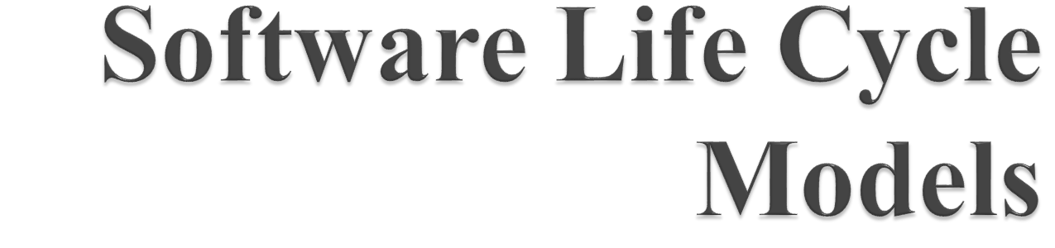

Slide 2

The Rapid Application Development Model was first proposed by IBM in 1980’s. The critical feature of this model is the use of powerful development tools and techniques.
A software project can be implemented using this model if the project can be broken down into small modules wherein each module can be assigned independently to separate teams. These modules can finally be combined to form the final product.

Slide 3
Development of each module involves the various basic steps as in waterfall model i.e analyzing, designing, coding and then testing, etc. as shown in the figure.
Another striking feature of this model is a short time span i.e the time frame for delivery(time-box) is generally 60-90 days.

Slide 4
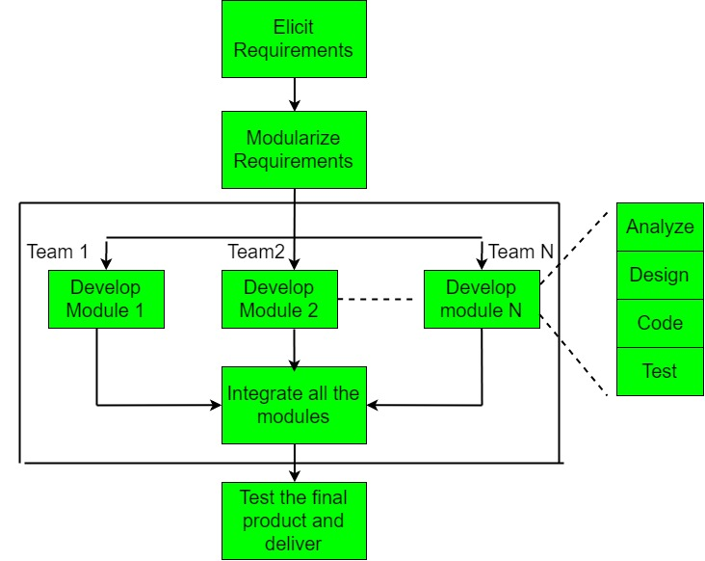

Slide 5
This model consists of 4 basic phases:
Requirements Planning –
It involves the use of various techniques used in requirements elicitation like brainstorming, task analysis, form analysis, user scenarios, FAST (Facilitated Application Development Technique), etc. It also consists of the entire structured plan describing the critical data, methods to obtain it and then processing it to form final refined model.

Slide 6
User Description –
This phase consists of taking user feedback and building the prototype using developer tools. In other words, it includes re-examination and validation of the data collected in the first phase. The dataset attributes are also identified and elucidated in this phase.

Slide 7
Construction –
In this phase, refinement of the prototype and delivery takes place. It includes the actual use of powerful automated tools to transform process and data models into the final working product. All the required modifications and enhancements are too done in this phase.

Slide 8
Cutover –
All the interfaces between the independent modules developed by separate teams have to be tested properly. The use of powerfully automated tools and subparts makes testing easier. This is followed by acceptance testing by the user.
The process involves building a rapid prototype, delivering it to the customer and the taking feedback. After validation by the customer, SRS document is developed and the design is finalised.

Slide 9

Use of reusable components helps to reduce the cycle time of the project.
Feedback from the customer is available at initial stages.
Reduced costs as fewer developers are required.
Use of powerful development tools results in better quality products in comparatively shorter time spans.
The progress and development of the project can be measured through the various stages.
It is easier to accommodate changing requirements due to the short iteration time spans.

Slide 10

The use of powerful and efficient tools requires highly skilled professionals.
The absence of reusable components can lead to failure of the project.
The team leader must work closely with the developers and customers to close the project in time.
The systems which cannot be modularized suitably cannot use this model.
Customer involvement is required throughout the life cycle.
It is not meant for small scale projects as for such cases, the cost of using automated tools and techniques may exceed the entire budget of the project.

Slide 11

The V-model is a type of SDLC model where process executes in a sequential manner in V-shape.
It is also known as Verification and Validation model.
It is based on the association of a testing phase for each corresponding development stage.
Development of each step directly associated with the testing phase.
The next phase starts only after completion of the previous phase i.e. for each development activity, there is a testing activity corresponding to it.

Slide 12
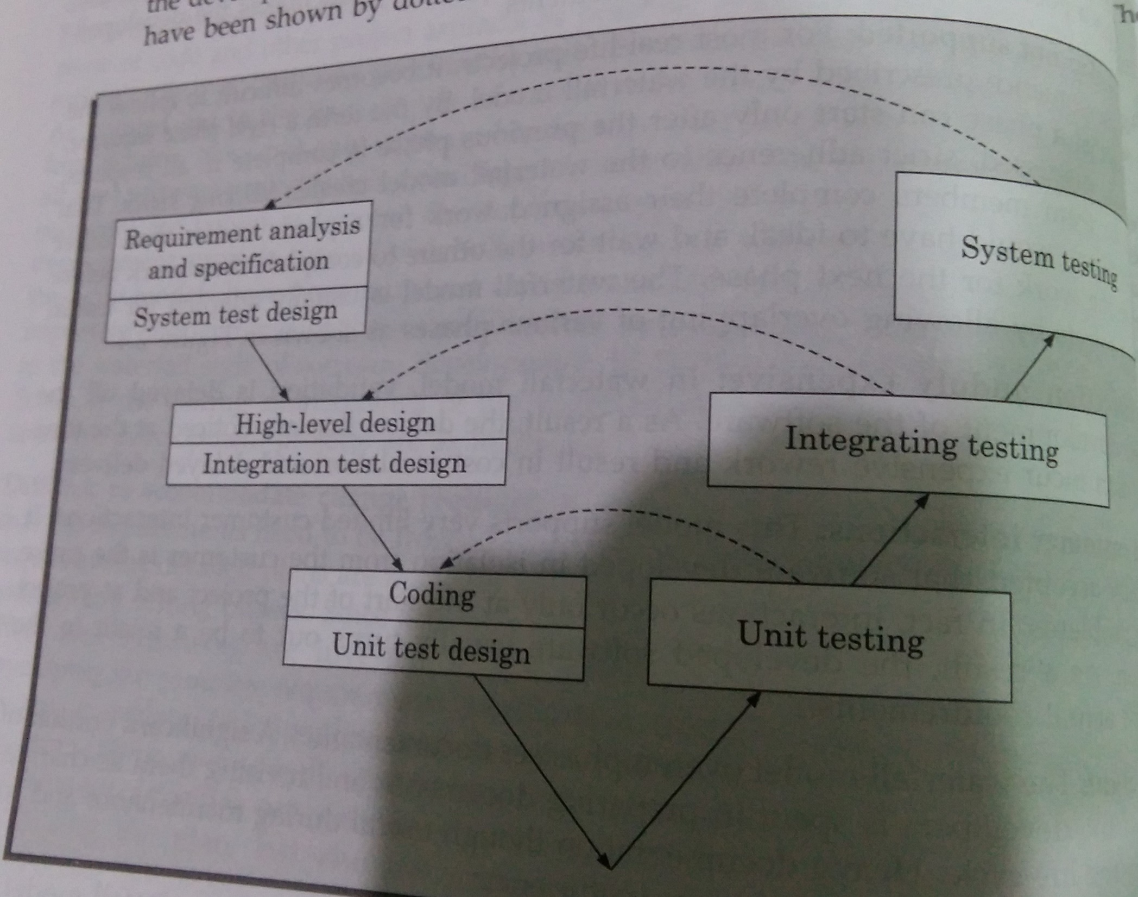

Slide 13
As shown in figure, there are two main phases-development and validation phases.
In each development phase, along with the development of a work product, test case design and the plan for testing the work product are carried out, whereas the actual testing is carried out in the validation phase. This validation plan created during the development phase is carried out in the corresponding validation phase.

Slide 14
In the validation phase, testing is carried out in three steps-unit, integration and system testing. The purpose of these three different steps of testing during the validation phase is to detect defects that arise in the corresponding phases of software development-requirements analysis and specification, design, and coding respectively.

Slide 15
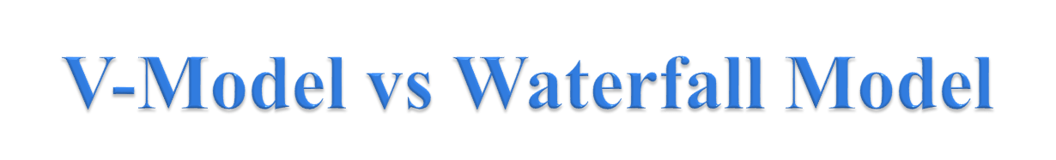
In waterfall model, testing activities are confined to the testing phase only, in V-Model, testing activities are spread over the entire life cycle.

Slide 16

Much of the testing activities are carried out in parallel with the development activities. Therefore, this model leads to a shorter testing phase and an overall faster product development as compared to the iterative model.
Since, test cases are designed when the schedule pressure has not built up, the quality of the test cases are usually better.
The test team is reasonably kept occupied throughout the development cycle in contrast to the waterfall model where the testers are active only during the testing phase.

Slide 17
In the V-Model, the test team is associated with the project from the beginning. Therefore, they built up a good understanding of the development artifacts, and this in turn, helps them to carry out effective testing of the software.

Slide 18

Being a derivative of the classical waterfall model, this model inherits most of the weaknesses of the waterfall model

Slide 19

Agile is a time-bound, iterative approach to software delivery that builds software incrementally from the start of the project, in
The Agile model was primarily designed to help a project to adapt to change requests quickly. So, the main aim of the Agile model is to facilitate quick project completion. To accomplish this task agility is required. Agility is achieved by fitting the process to the project, removing activities that may not be essential for a specific project. Also, anything that is wastage of time and effort is avoided.

Slide 20
Actually Agile model refers to a group of development processes. These processes share some basic characteristics but do have certain subtle differences among themselves. A few Agile SDLC models are given below:
Crystal
Atern
Feature-driven development
Scrum
Extreme programming (XP)
Lean development
Unified process

Slide 21

To establish close contact with the customer during development and to gain a clear understanding of various requirements, each Agile project usually includes a customer representative on the team.
Agile model relies on working software deployment rather than comprehensive documentation.
Frequent delivery of incremental versions of the software to the customer representative in intervals of few weeks.
Requirement change requests from the customer are encouraged and efficiently incorporated.

Slide 22
It emphasizes on having efficient team members and enhancing communications among them is given more importance.
It is recommended that the development team size should be kept small (5 to 9 peoples) to help the team members meaningfully engage in face-to-face communication and have collaborative work environment.
Agile development process usually deploy Pair Programming. In Pair programming, two programmers work together at one work-station. One does coding while the other reviews the code as it is typed in. The two programmers switch their roles every hour or so.

